Slide 1
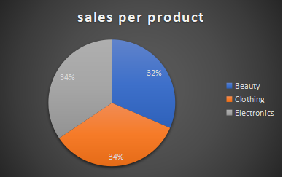
BB FISH BUSINESS SALES REPORT

